Slide 1

Core Coders —
Smart Research Assistant
Trusted, cited answers from research papers — with live update tracking
Team: [H. UdayKumar] (Lead), [P. Venkata Teja] (Frontend), [S. Sairam] (Designer), [K. Bhanu] (Research/Support), [M. Madhan] (Research/Support)
Track: FlexPrice × Pathway — Smart Research Assistant
Email: [udaykumarhaibathi@gmail.com
GitHub: [github.com/udaykumar0515/Smart-Research-Assistant]
HackwithHyderabad Hackathon — Problem Statement: Smart Research Assistant

Slide 2

Problem Statement
Researchers face information overload with long research papers.
Existing AI/chatbots give uncited or outdated answers.
Tracking new updates on a paper/topic is difficult.
Example: A student spends hours verifying accuracy from multiple sources.

Slide 3

Why Existing Tools Fail
Search Engines → Only give links, no direct answers.
Chatbots → Often uncited, sometimes outdated.
Summarizers → Lose context, miss updates.
Goal: a single tool that provides citation-first answers + update tracking.
No single tool ensures citations, freshness, and trust.

Slide 4
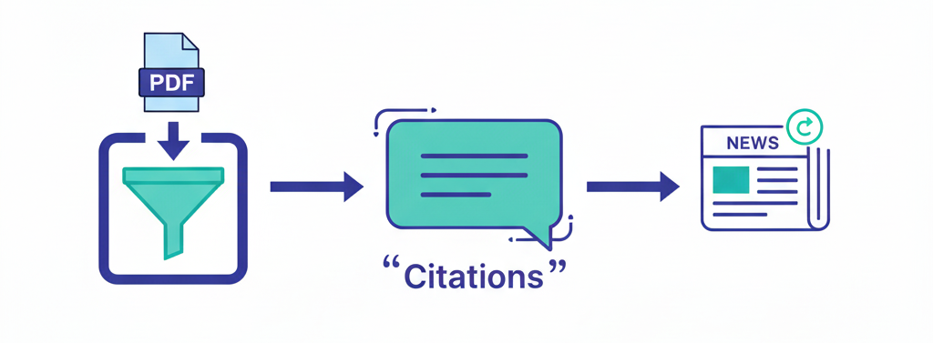
Our Solution
An AI-powered research assistant that delivers cited answers from uploaded papers and keeps you updated with latest news and improvements.
Multi-doc retrieval with citations from source pages.
Citation-first answers → always show evidence.
Subscription updates on relevant topics
Flexprice model → usage-based credits system.
Your research companion that ensures trust, freshness, and efficiency.

Slide 5







How It Works
Upload & parse
User uploads research papers (PDFs).
Chunk & embed
Paper is split into smaller sections.
Topic profile
System builds keywords from paper.
Local retrieval first
Answer pulled directly with citations.
LLM fallback
If unclear, system generates a concise synthesis.
Subscription updates
Tracks new news and delivers deltas.
Efficient pipeline → Retrieval first, LLM only when needed, updates always tracked.

Slide 6

MVP Features
UI Mock (Implemented) ✅
Upload & parse PDFs
Multi-paper chat (ask across several papers together)
Retrieval with citation chips (demo answers)
Chat UI flow (Q&A interface)
Subscription toggle + update badge (demo flow)
Credits/usage log (functional Flexprice counter with server-side deduction)
Hackathon Build — Planned Next Steps🔧
Real document embedding + retrieval pipeline
Gemini API fallback for out-of-paper questions
Subscription polling for live updates (news/source integration)
Credits deduction for LLM usage (API integration planned)
Our MVP focuses on UI, usability, and proof of concept — backend integrations are documented and planned.

Slide 7

Tech Stack & Choices
Frontend (MVP focus)
React + Vite (core framework)
TailwindCSS (styling)
TypeScript (important for React projects)
Local demo data + state simulation (for prototype demo)
Planned Integrations (Next Phase)
Gemini API (LLM fallback)
Vector database / embeddings (retrieval)
Simple polling script (subscription updates)
Local storage (usage log / credits)
We designed for retrieval-first answers → efficient, low-cost, and trustworthy.

Slide 8
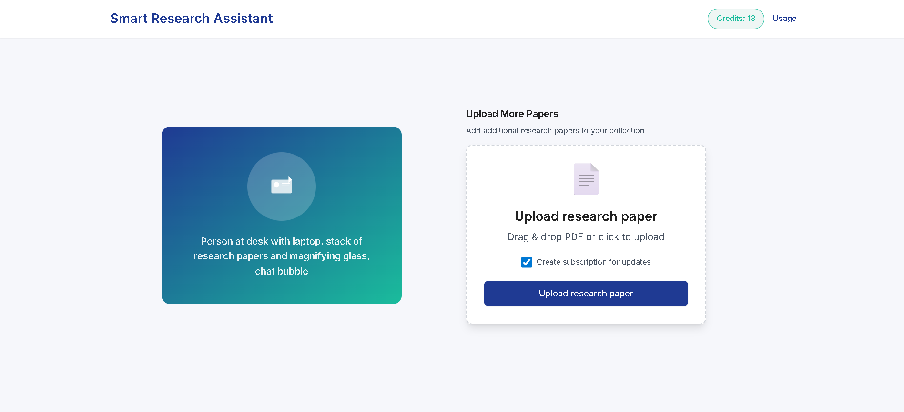
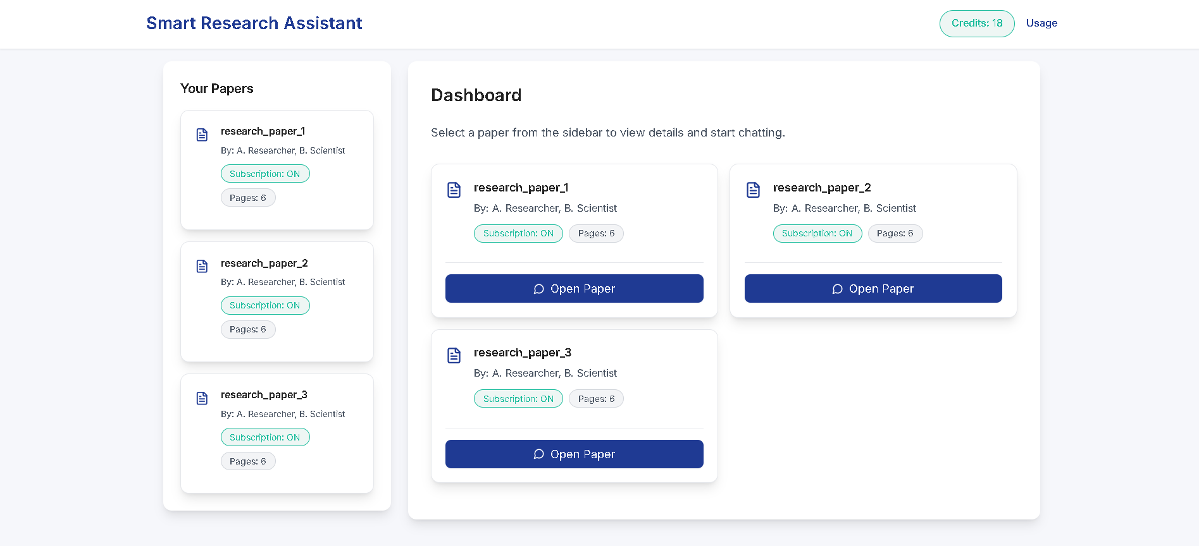
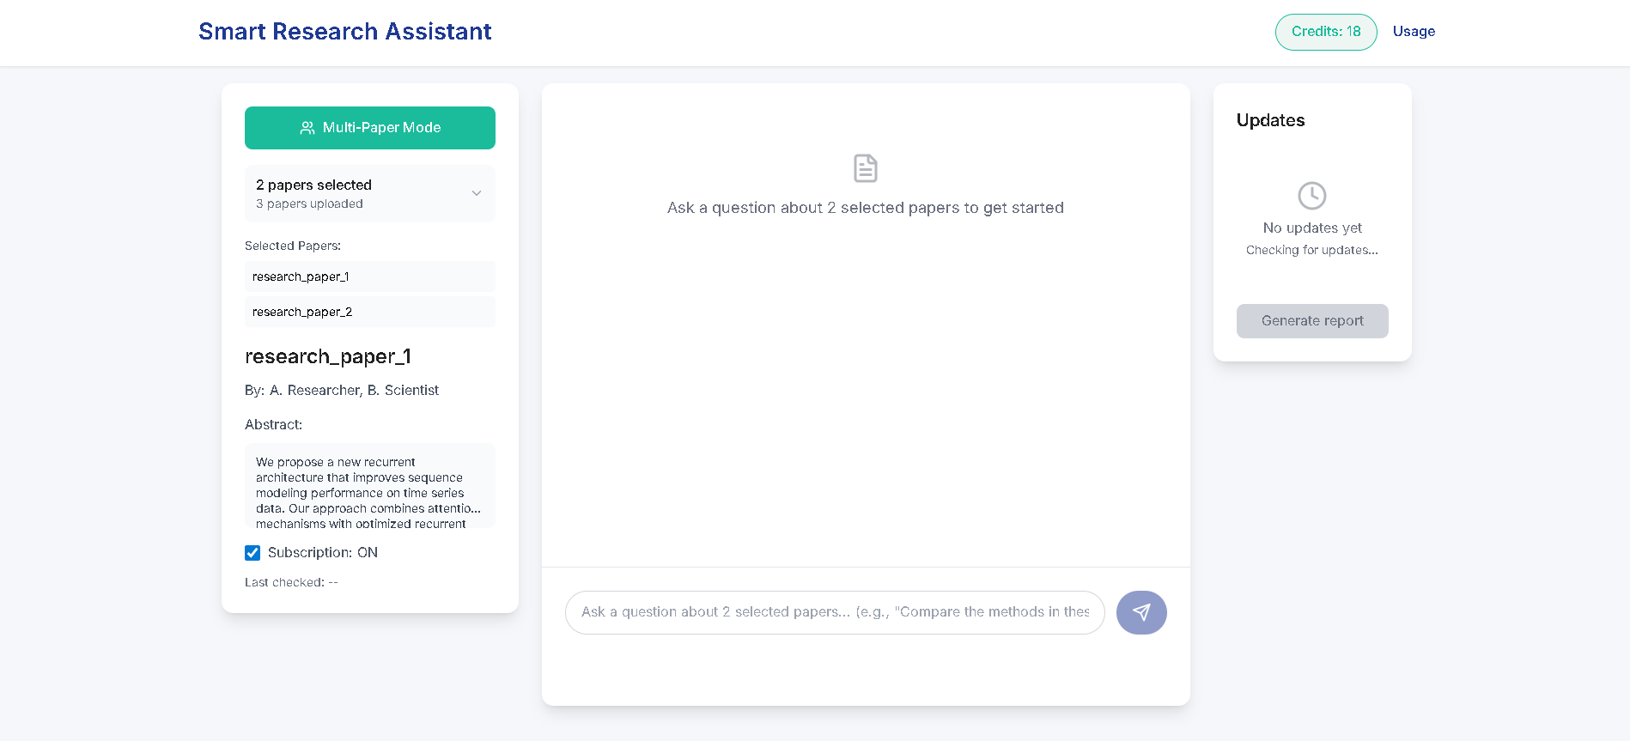
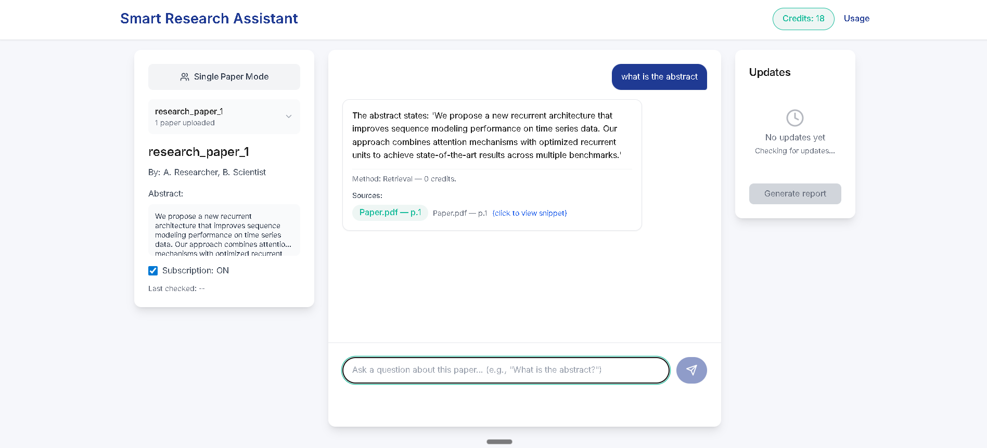
Demo Screenshots (MVP)
Landing Page — Clean upload UI with drag-and-drop
and navigation
Dashboard — Grid view of uploaded papers, selection states,
and quick actions.
Multi-Paper Mode — Select multiple papers and query
across them simultaneously.
Chat Interface — Ask natural-language questions; answers
show citation chips and source metadata.

Slide 9
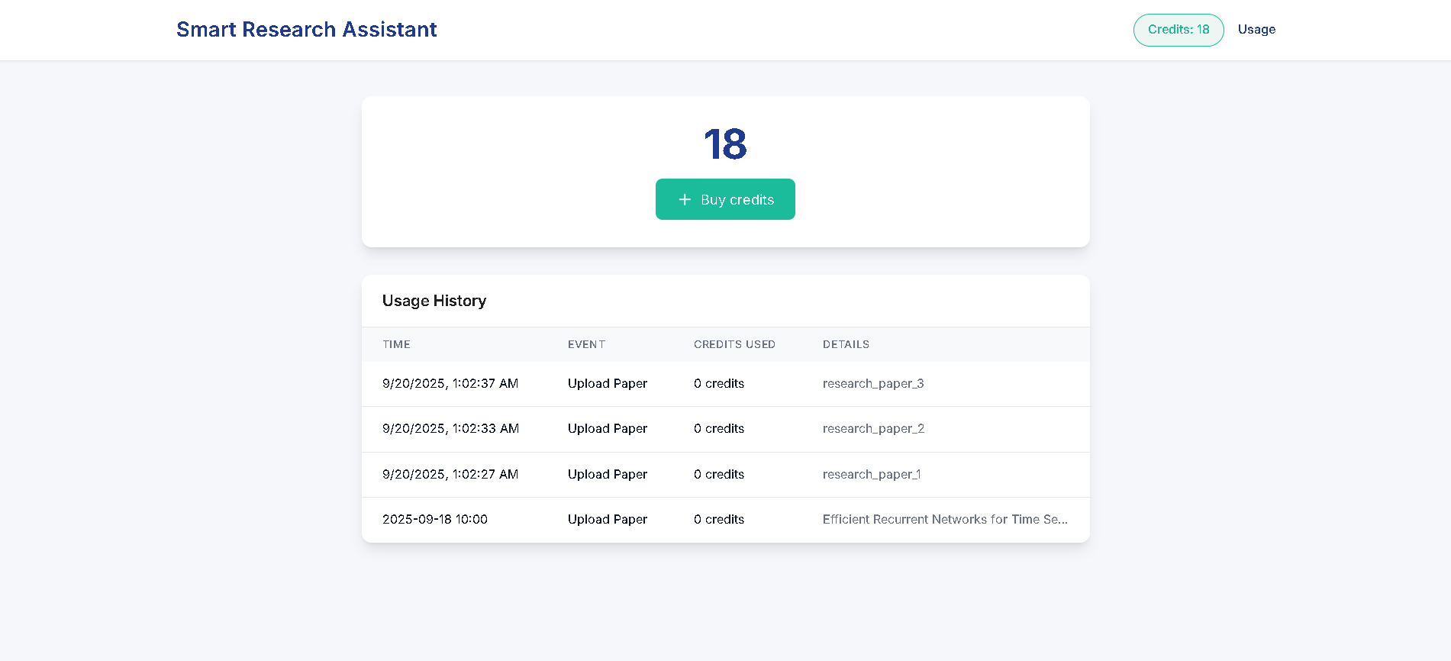
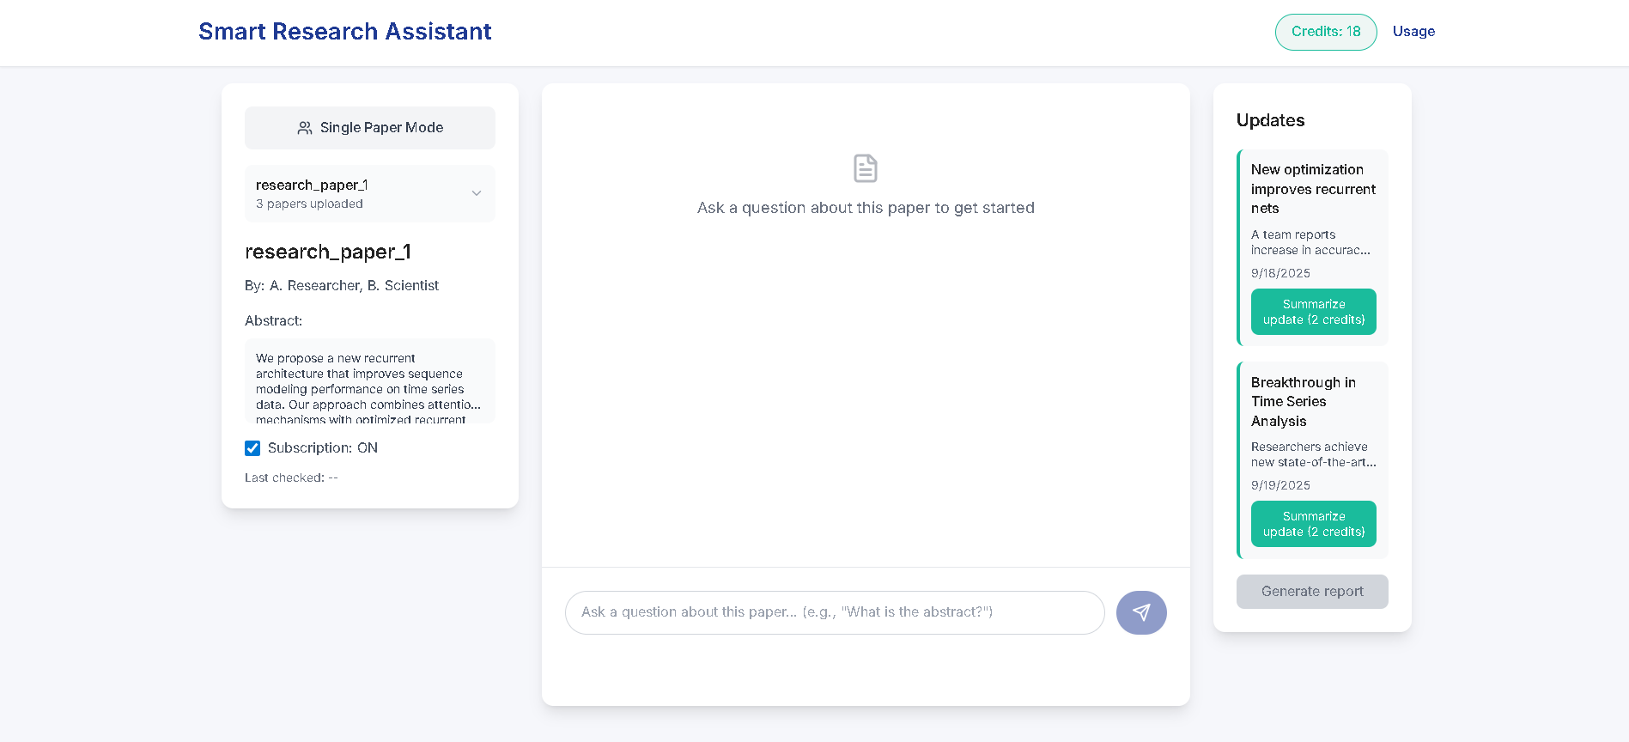
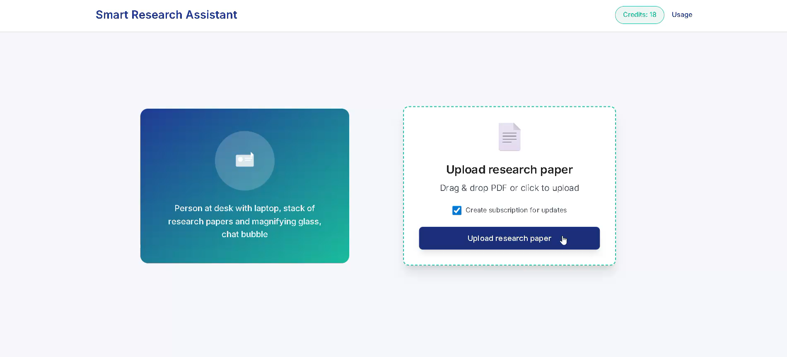
Demo Screenshots (MVP)
Usage & Credits — Credits balance, transaction log, and mock purchase flow shown.
Updates Panel — New research updates, summarize button, and cost per summary.
Demo Video :
Upload → Ask → Citation chips → Confirm LLM fallback → Credits deducted (local simulation)

Slide 10
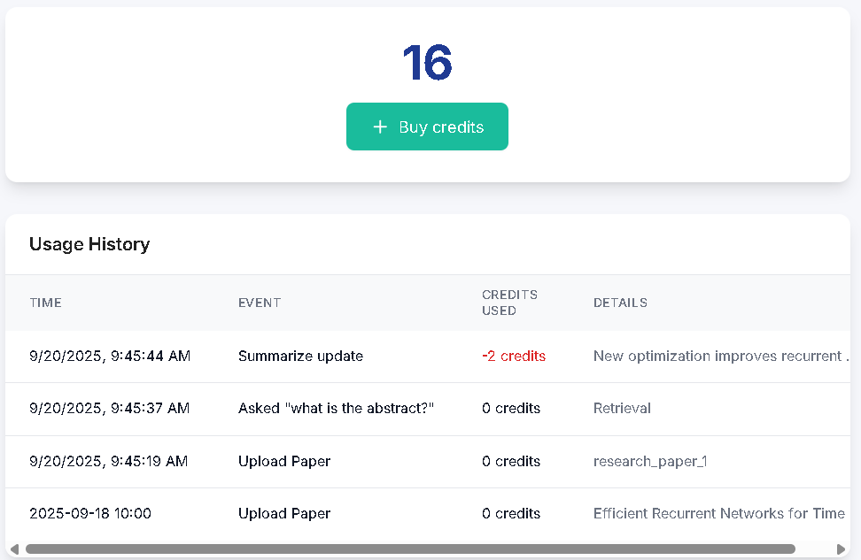
FlexPrice (Billing & Usage Model)
Transparent credits that charge only for expensive LLM work — retrievals are free.
Credits cost (demo simulation))
Event | Credits (demo)
Upload & index (one paper) — UI only | 0
Retrieval-only answer (local) | 0
LLM Synthesis (fallback) | 3
Delta summary (per new article) | 2
Export report (PDF) | 2
Bulk export (all summaries) | 8
Manual review / human-assisted export | 10
Ask → local retrieval = 0 credits.
If fallback required → confirm (cost 3 credits) → server deducts credits + transaction log updated.
Credits counter is fully functional (server-side).

Slide 11

Impact & Users
Hypothesis — Reduce initial literature verification time by ~40% (pilot target).
Graduate students — faster, cited verification (less time wasted).
Academic researchers — multi-paper comparison + traceability.
R&D engineers — quick delta summaries for decisions.
Professors/course designers — timely curriculum updates.
Pilot targets (to validate): verification time -40%.
% of queries with direct citation >70%.
weekly relevant update detection >5/topic.
A master’s student asks: ‘Has this architecture been improved?’ — gets a cited answer and a 1-sentence update summary in 30 seconds
Impact shown is a pilot target (to be validated in studies).

Slide 12

Thank you — Prototype Built · Demo Ready
Backend integrations (embeddings, Gemini fallback, live updates) are documented and will be enabled in the demo round if shortlisted.
Quick demo flow: Upload → Cite-first answers → LLM fallback → Update summaries.
Contact: udaykumarhaibathi@gmail.com
GitHub: github.com/udaykumar0515/Smart-Research-Assistant
Team: [H. UdayKumar] (Lead), [P. Venkata Teja] (Frontend), [S. Sairam] (Designer), [K. Bhanu] (Research/Support), [M. Madhan] (Research/Support)

